Slide 1

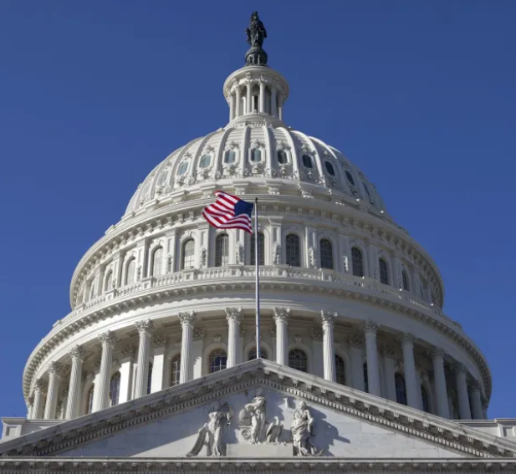
Formal Demography Workshop
UC Berkeley
June 8, 2023
Congressional Symmetry:
Applications of the Stationary Population Identity
James R. Carey
UC Davis

Slide 2
Challenge & discovery
1
2
Interdisciplinary adventure
Organization
3
World population
Carry-away
4

Slide 3
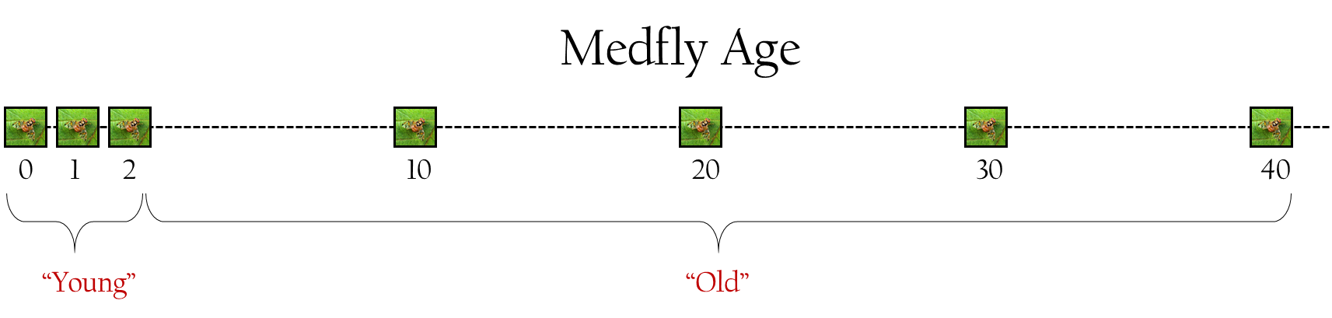


Challenge:
Estimating age structure in insect populations
INSECT AGING METHODS:
Wear-and-tear
Biochemical
Gene expression
Ovary status
1 day old
10 days old
100 days old

Slide 4

Captive Life Span
Pre-capture
Life in Wild
??
??
??
captive life span
??
birth
capture
death
What does captive segment tell us?
Notes:
Born in wild, lives life for an unknown period and is captured, at which time is brought to lab and monitored through death
What tell us?
Problem: Don’t know whether captured 1 day after emerging or 100 days afterwards

Slide 5
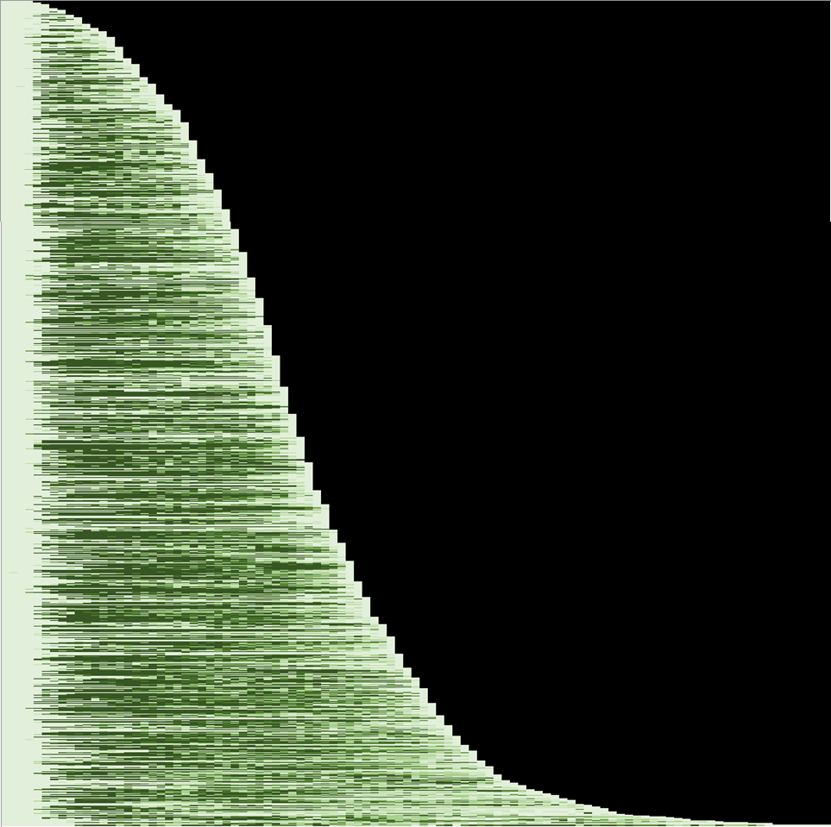
1,000
Capture age
1
Medfly Survival
and Reproduction
800
2
600
lived left
3
400
4
200
5
0
0
10
20
30
40
50
60
70
80
AGE (days)

Slide 6
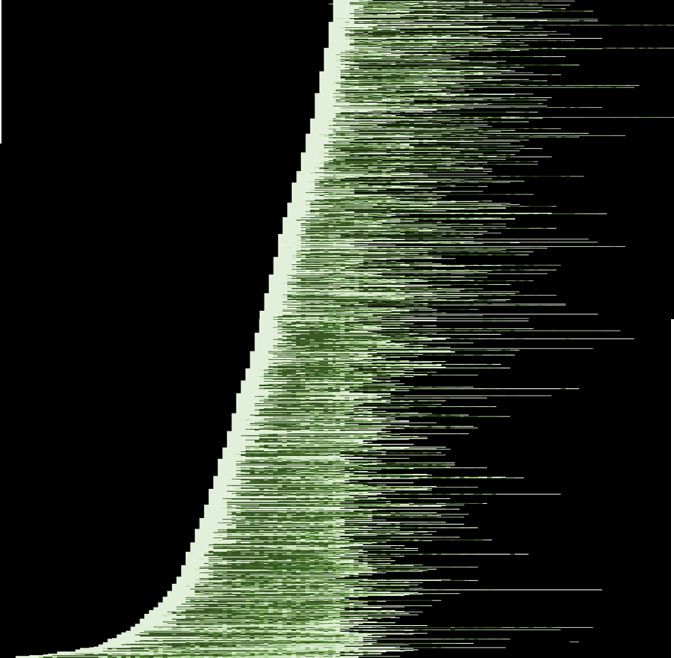
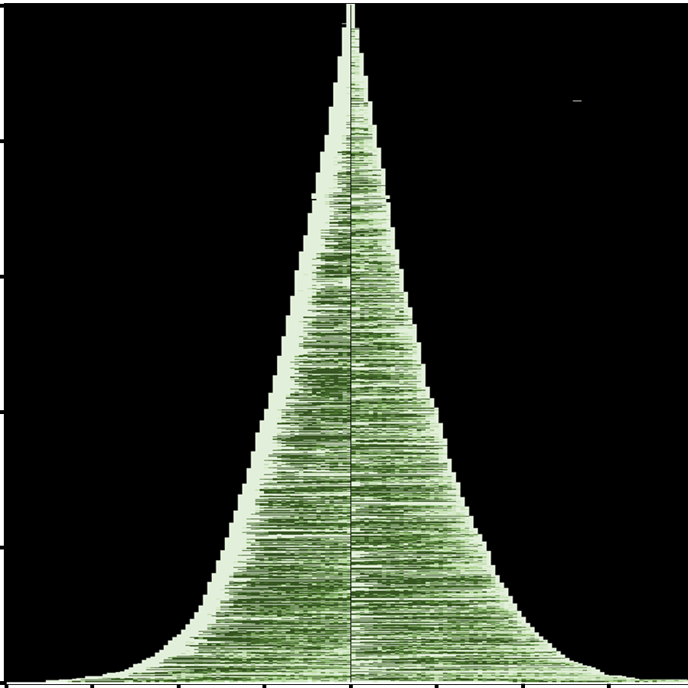
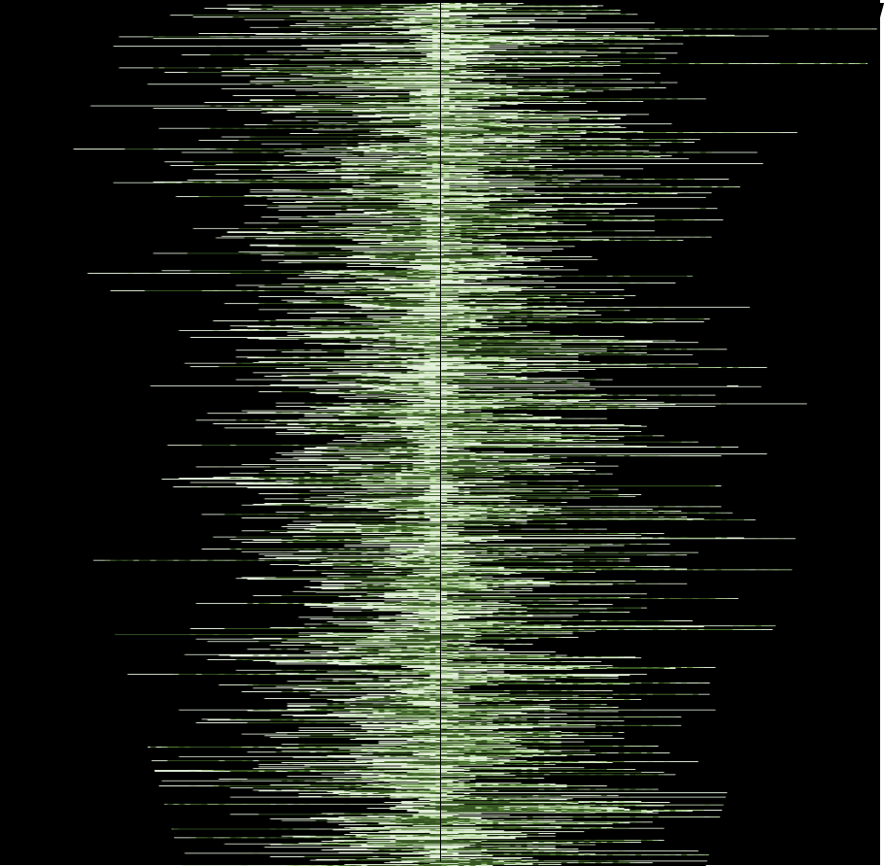
Medfly Life Lived and Left
1,000
Stationary Population Identity:
The proportion of individuals x days old
in a population equals
the proportion that have x days left to live
800
Lived
Left
600
400
200
0
80
60
40
20
0
20
40
60
80
Days

Slide 7
Population

Slide 8
How to determine the age structure of a stationary population without knowing the age of any single individual within it.

Slide 9
Hypothetical Population

Slide 10
Population Sample
n=40
40
n=30
n=25
30
20
n=5
0
0
1
2
3
AGE

Slide 11
Population Sample
40
30
20
0
0
1
2
3
AGE
deaths
days 0 to 1
40
Post-capture Deaths
30
20
0
0
1
2
3
TIME TO DEATH

Slide 12
Population Sample
40
30
20
0
0
1
2
3
AGE
deaths
days 0 to 1
40
deaths
days 1 to 2
Post-capture Deaths
30
20
0
0
1
2
3
TIME TO DEATH

Slide 13
Population Sample
40
30
20
0
0
1
2
3
AGE
deaths
days 0 to 1
40
deaths
days 1 to 2
deaths
days 2 to 3
Post-capture Deaths
30
20
0
0
1
2
3
TIME TO DEATH

Slide 14
Population Sample
40
30
20
0
0
1
2
3
AGE
deaths
days 0 to 1
40
deaths
days 1 to 2
deaths
days 2 to 3
Post-capture Deaths
30
20
deaths
days 3 to 4
0
0
1
2
3
TIME TO DEATH

Slide 15
Population Sample
n=40
40
n=30
n=25
30
20
n=5
0
0
1
2
3
AGE
Life table identify
n=40
40
n=30
n=25
Post-capture Deaths
30
20
n=5
0
0
1
2
3
TIME TO DEATH

Slide 16
The proportion of individuals x days old in a population equals the proportion that have x days left to live

Slide 17
Proportion Age x
Life Table Identity
0.015
Fraction exactly 90-95 years to live
U.S. Population
(2000 female life table)
0.010
exactly equal
0.005
Fraction exactly ages 90-95 years
0.000
0
50
90
95
AGE (years)

Slide 18
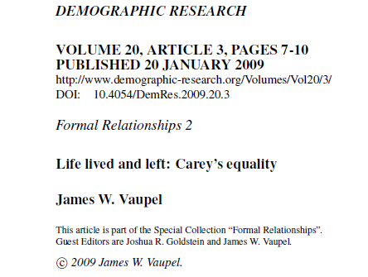

Slide 19
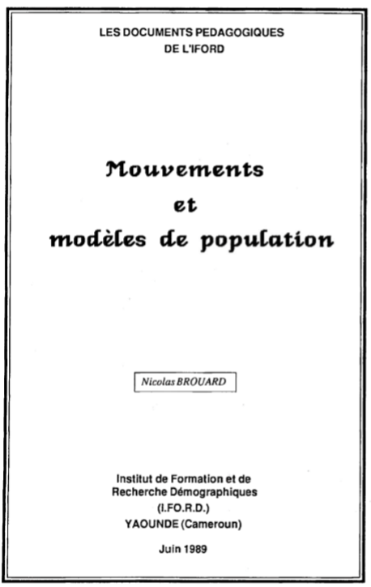
Nicolas Brouard
Cameroon (1989)

Slide 20
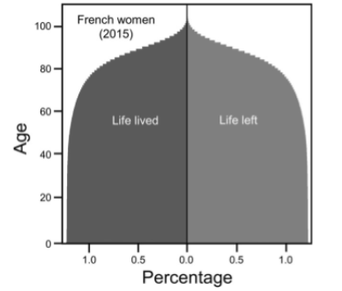
French women
(2015)
Life lived
Life left
Age
Percentage

Slide 21
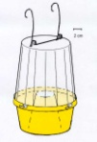
Captive Cohort Method
Larva-infested
hosts

Slide 22
Captive Cohort Method
captive
deaths (field)
Deaths
Ages
unknown
Captive Age
captive deaths
(predicted)
reference
deaths (lab)
Deaths
Larva-infested
hosts
Age
known
(x=0)
Age

Slide 23

Example Application #1:
Medfly Population Age Structure

Slide 24
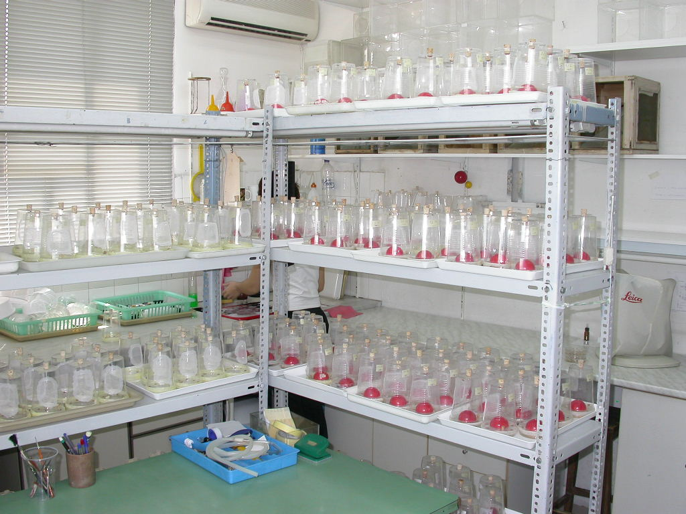
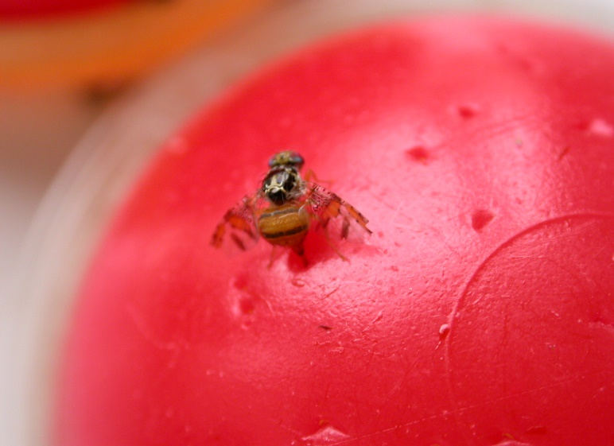
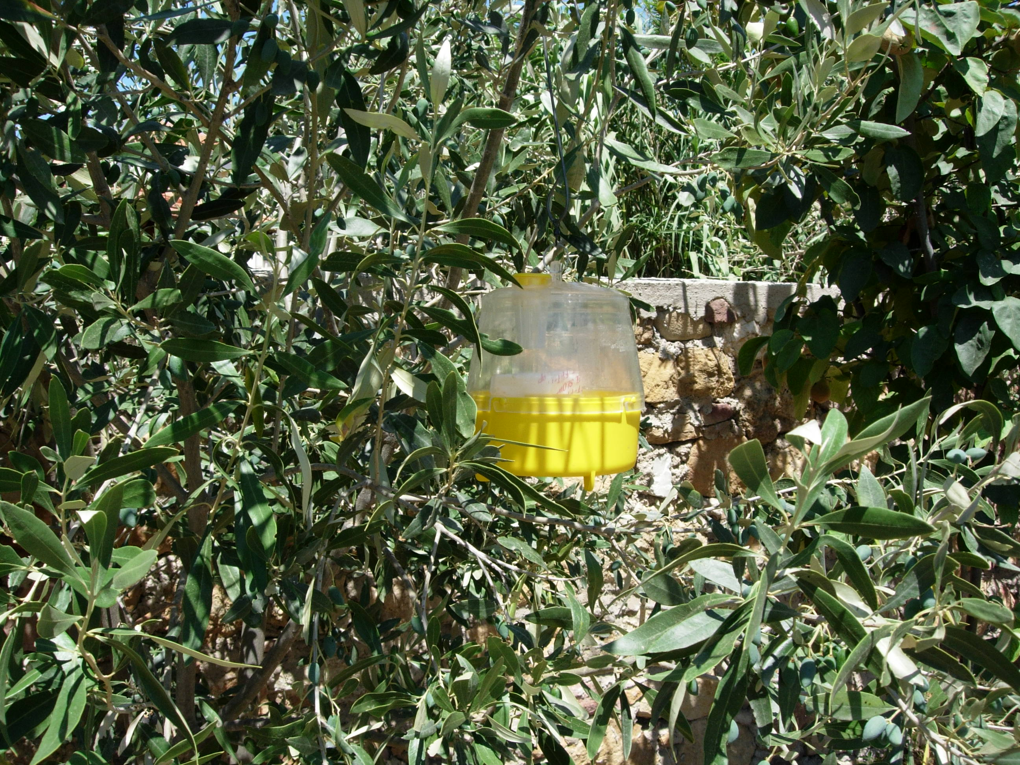
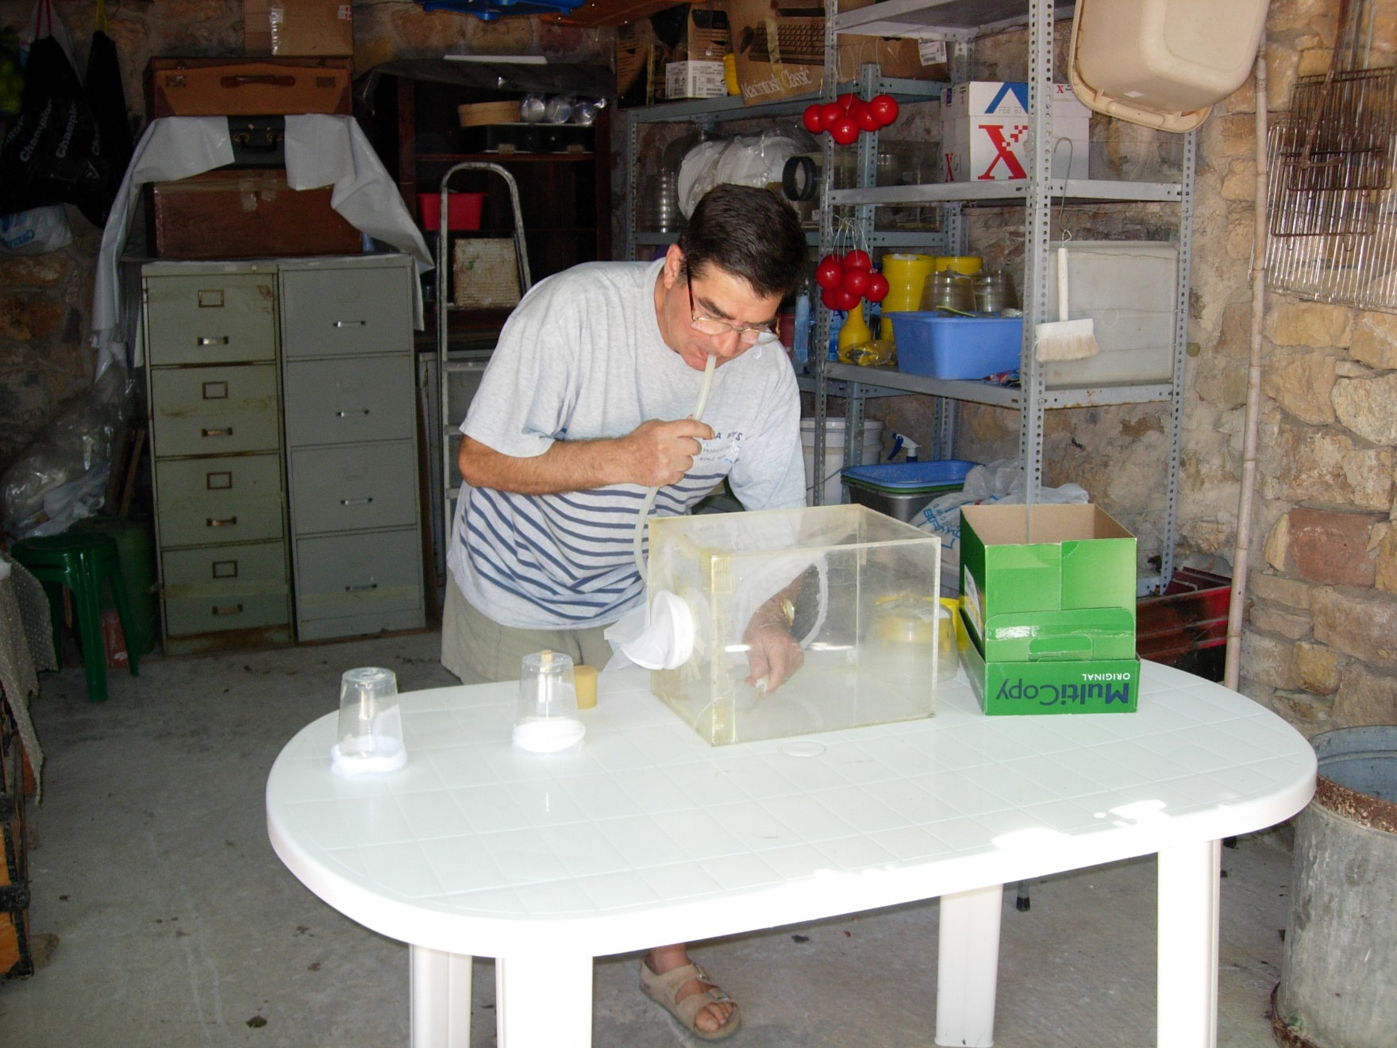
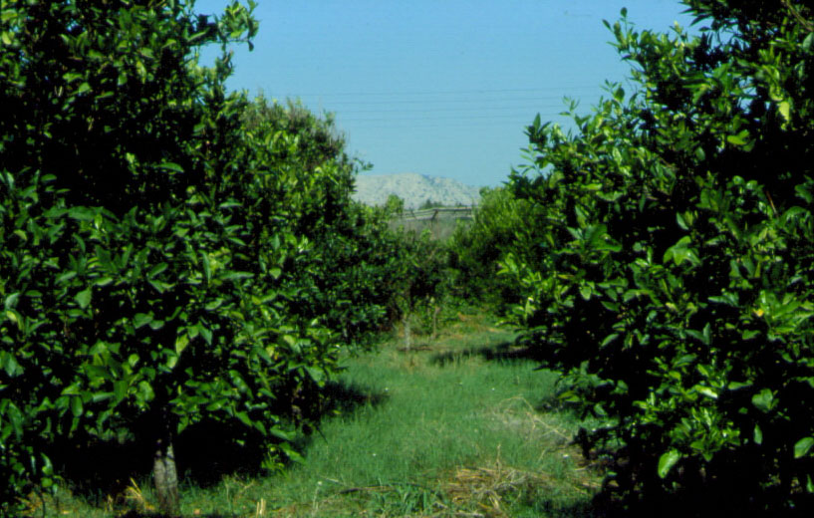
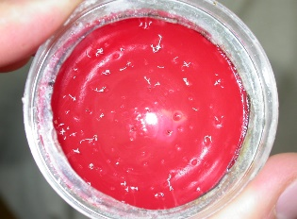
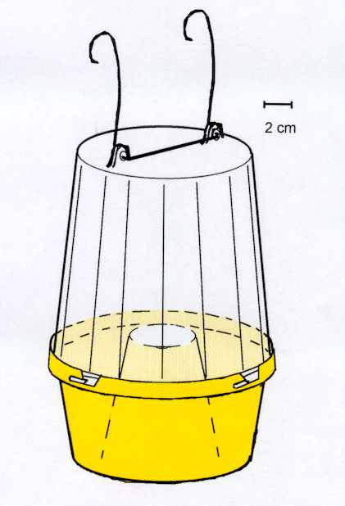
Medfly Lab Cages
Trap in tree
Medfly transfer
Citrus grove
Medfly
trap
Notes:
Professional meetings
Proposals
Teaching
Business report organization’s executives

Slide 25
1.0
Female
0.8
Reference
0.6
Field-captured
Survival
Stationary
0.4
0.2
0.0
0
30
60
90
120
150
180
Chronological Age or Captive Endurance (days)
Notes:
Professional meetings
Proposals
Teaching
Business report organization’s executives

Slide 26
Three-year Post-capture Longevity Trends
in Wild-caught Medflies
180
Females
160
140
120
Captive Longevity
(days)
100 days
100
80
60
40
20
0
2003
2004
2005
Notes:
Professional meetings
Proposals
Teaching
Business report organization’s executives

Slide 27
Monthly Estimates of Female Medfly
Population Age Structure (Chios, Greece)
60
n=43
n=434
n=624
n=822
n=535
n=205
50
40
AGE (days)
30
20
10
0
0.00
0.07/0.00
0.07/0.00
0.07/0.00
0.07/0.00
0.07/0.00
0.07/0.00
Frequency
Notes:
Professional meetings
Proposals
Teaching
Business report organization’s executives

Slide 28
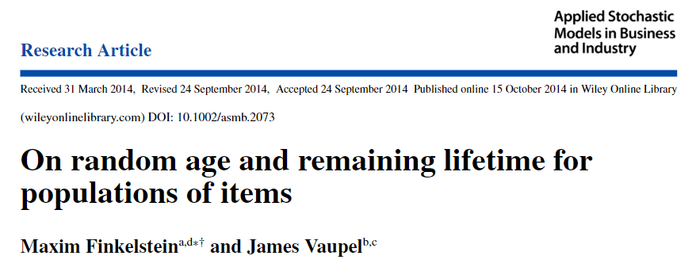

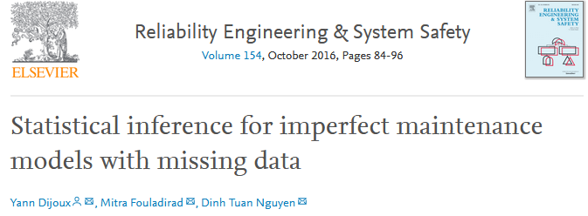
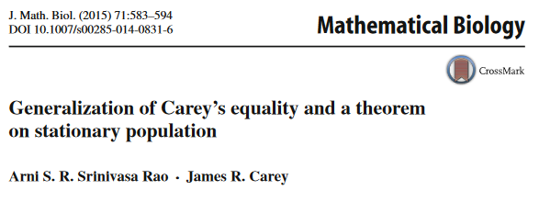
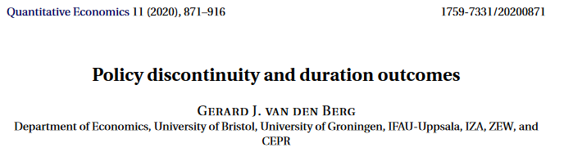
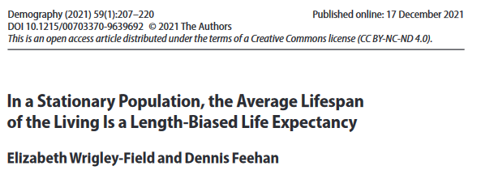
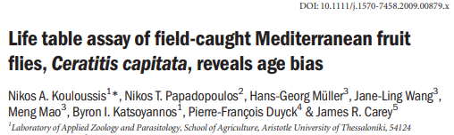
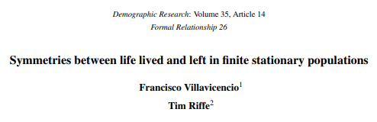


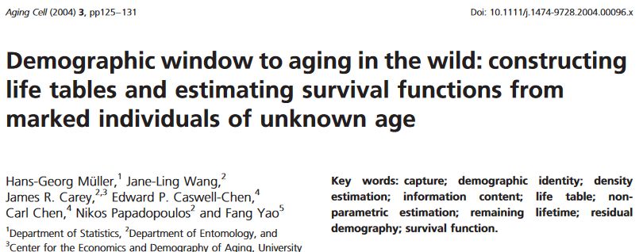
Journal Citations
Blood
Quantitative Economics
Applied Stochastic Models Business
Reliability Engineering
Mathematical Biology
Statistical Models in Biomedicine
Demography
Scientific Reports
Animal Ecology
Frontiers in Ecology/Evolution
Notes:
Professional meetings
Proposals
Teaching
Business report organization’s executives

Slide 29
U.S. Congress:
Years Served Structure

Slide 30


U.S. Senate
Composition
1-10 yrs
100
11-20 yrs
21-40 yrs
>40 yrs

Slide 31

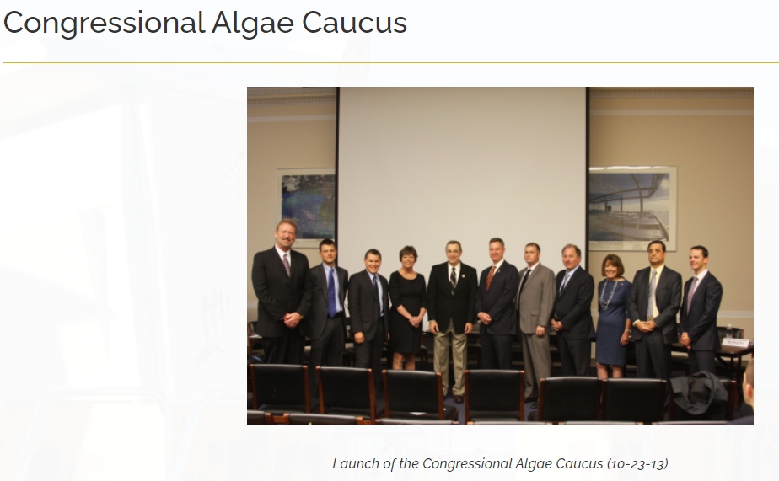
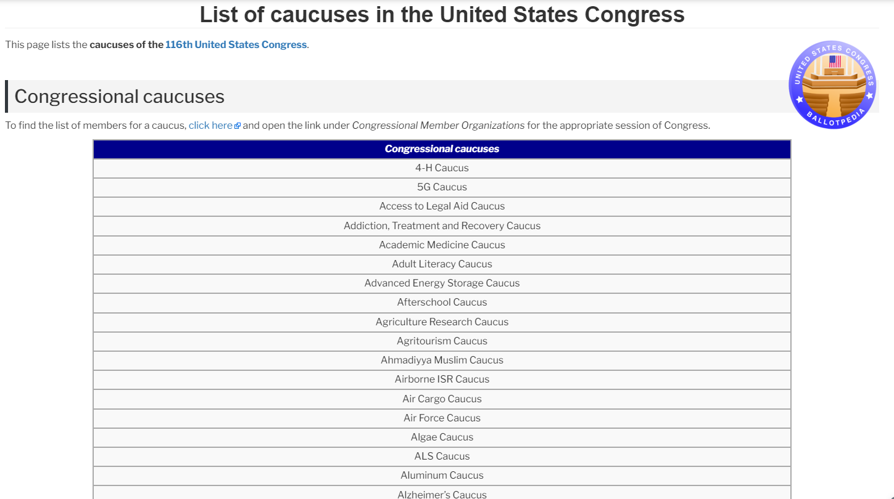
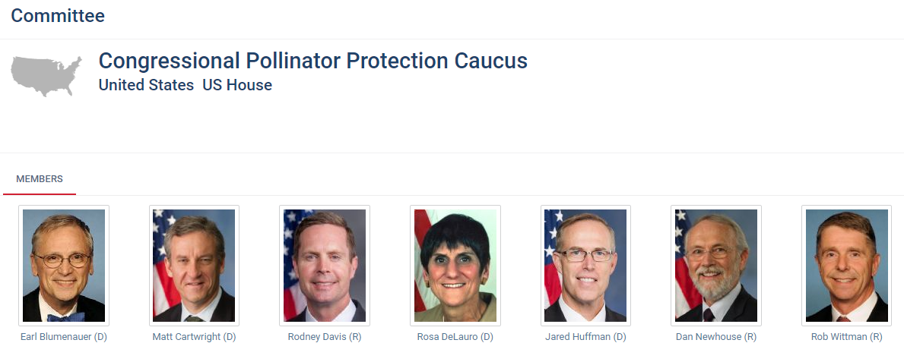

Slide 32
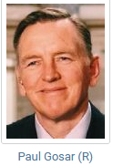
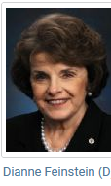
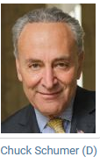

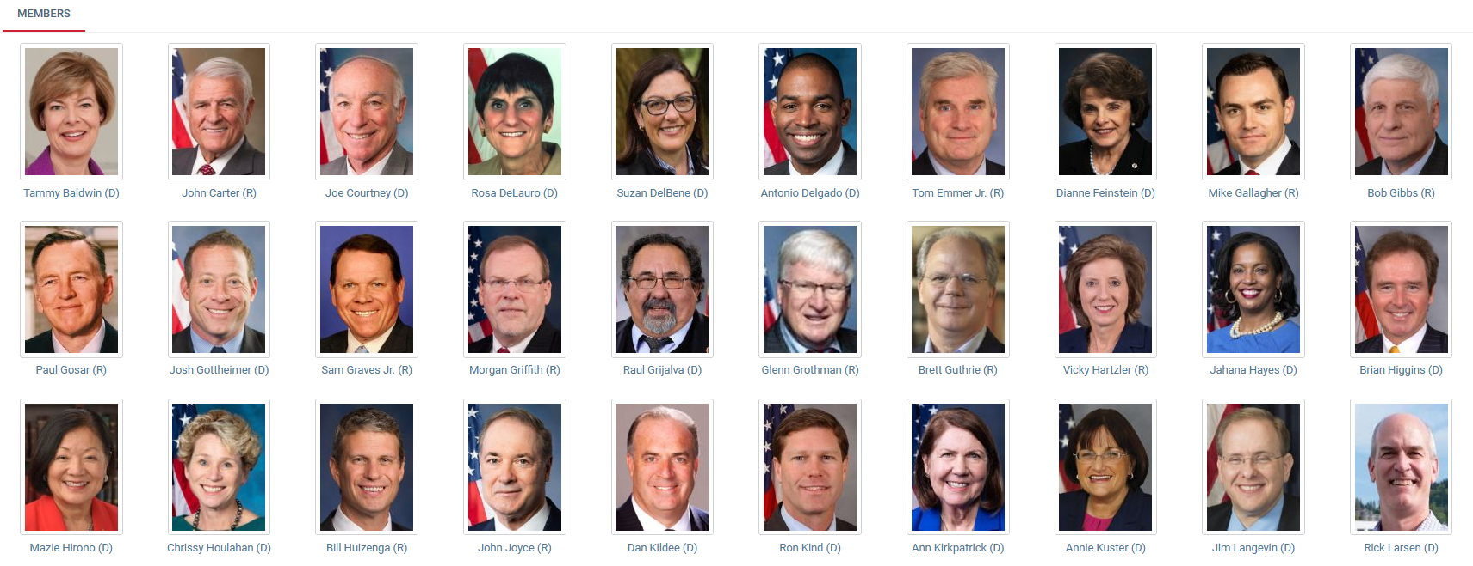
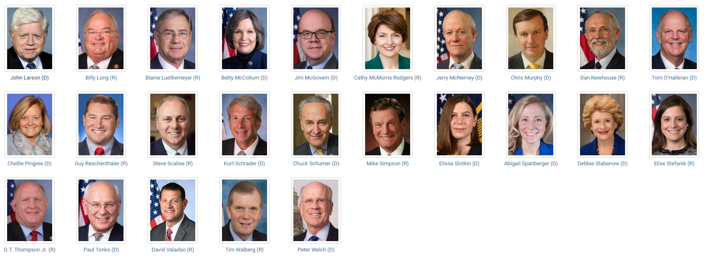
Notes:
Professional meetings
Proposals
Teaching
Business report organization’s executives

Slide 33
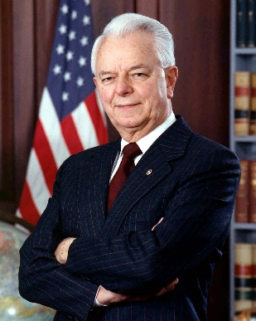
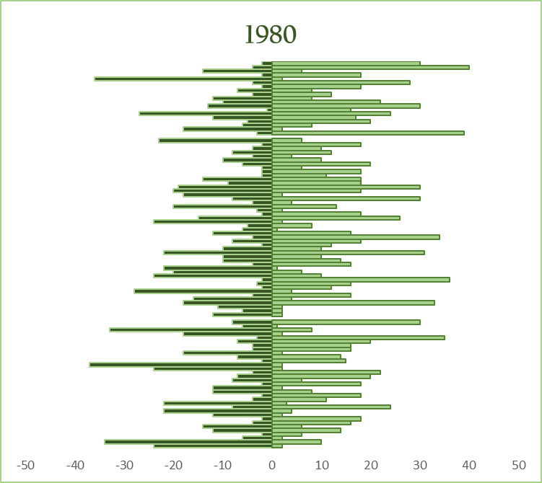
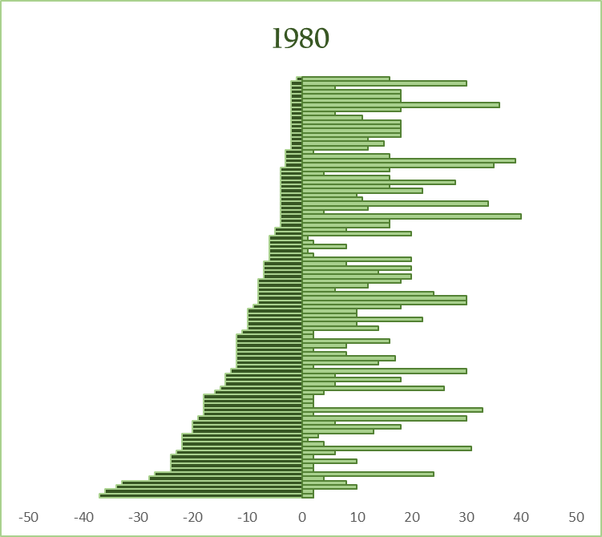
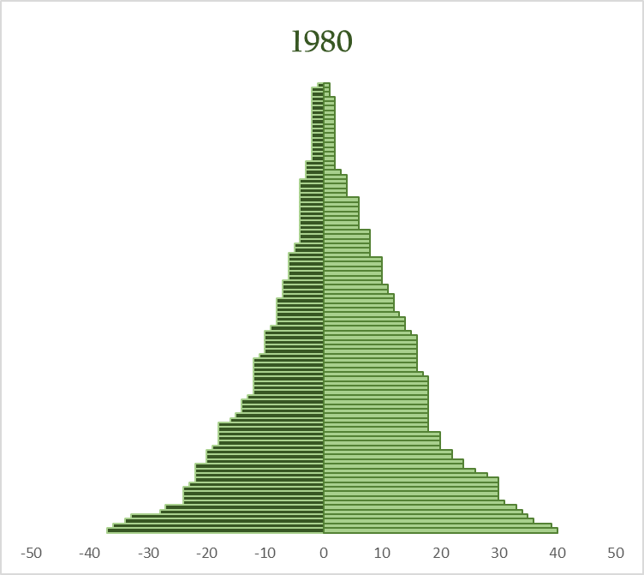
Senate Incumbency History (1980)
Robert Byrd
1959
2010

Slide 34
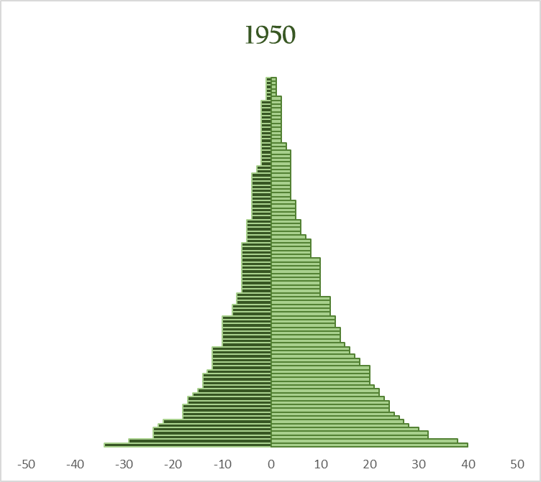
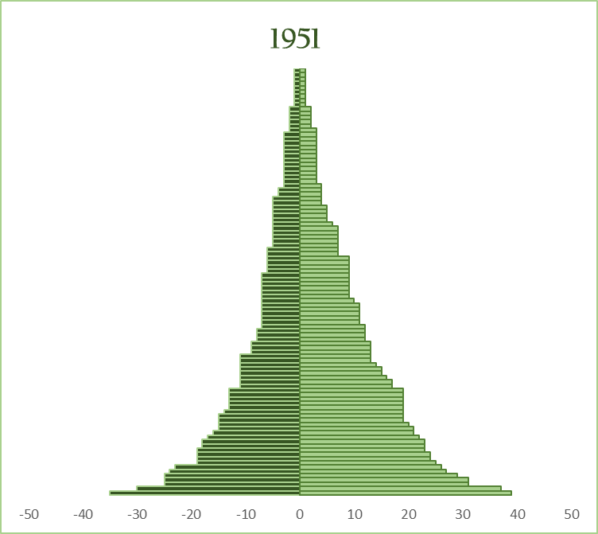
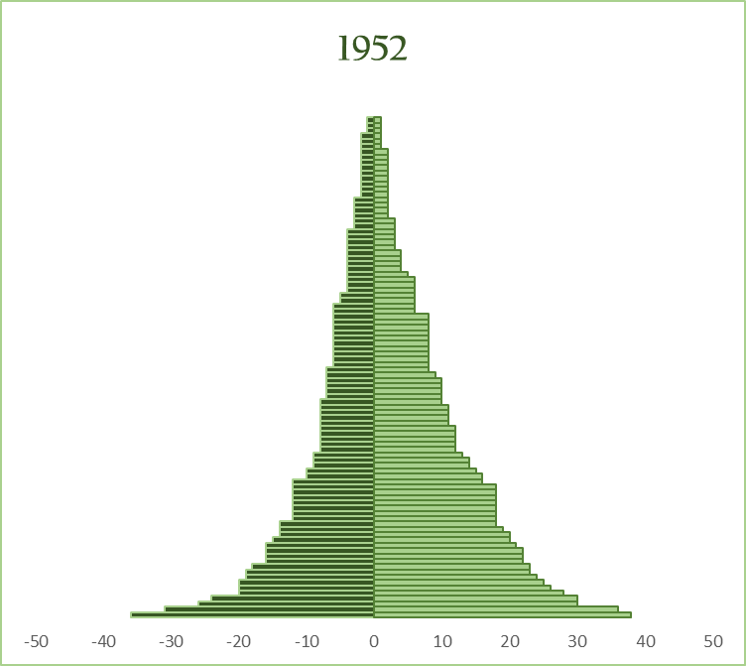
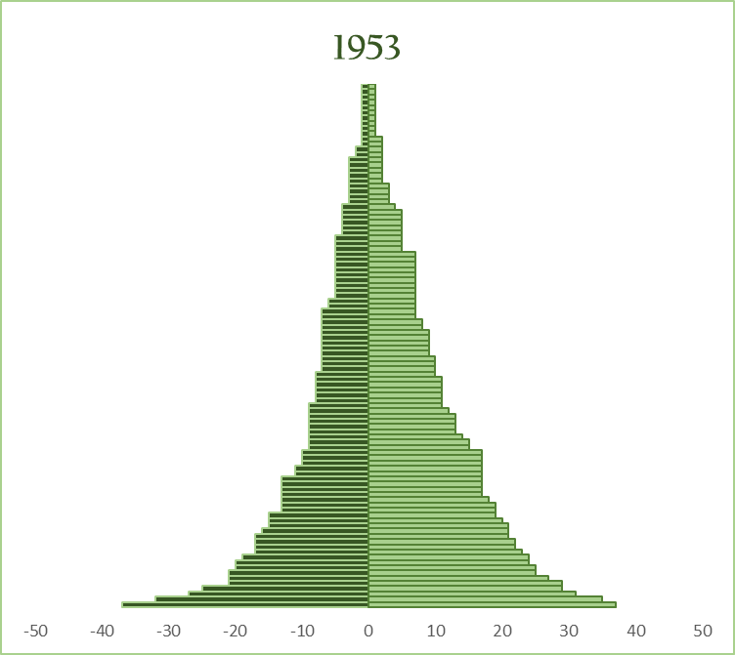
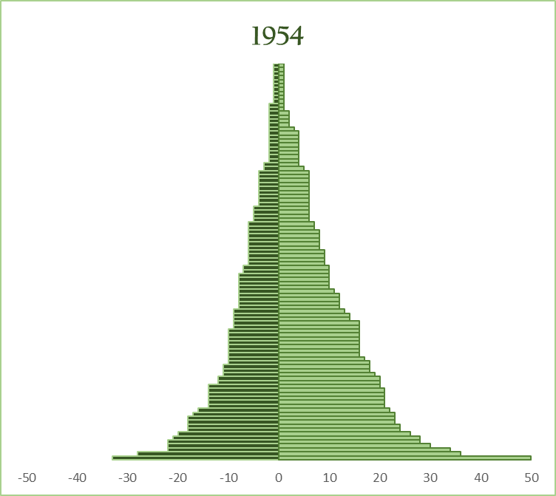
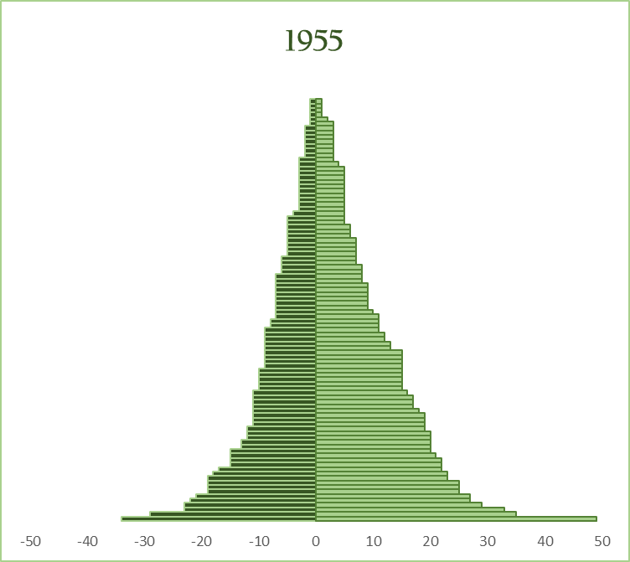
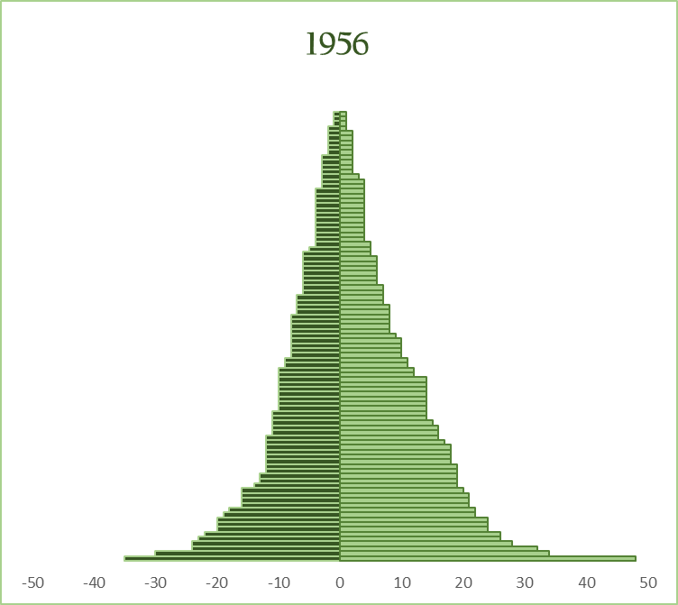
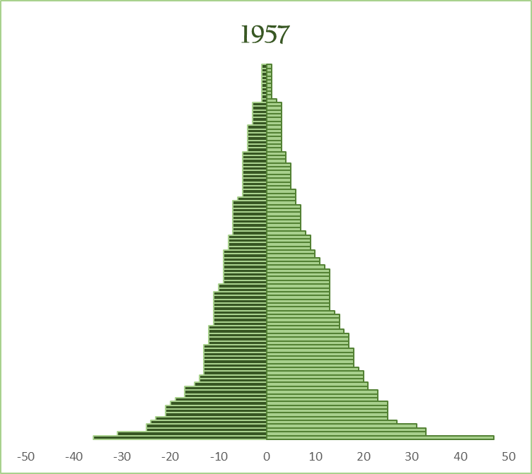
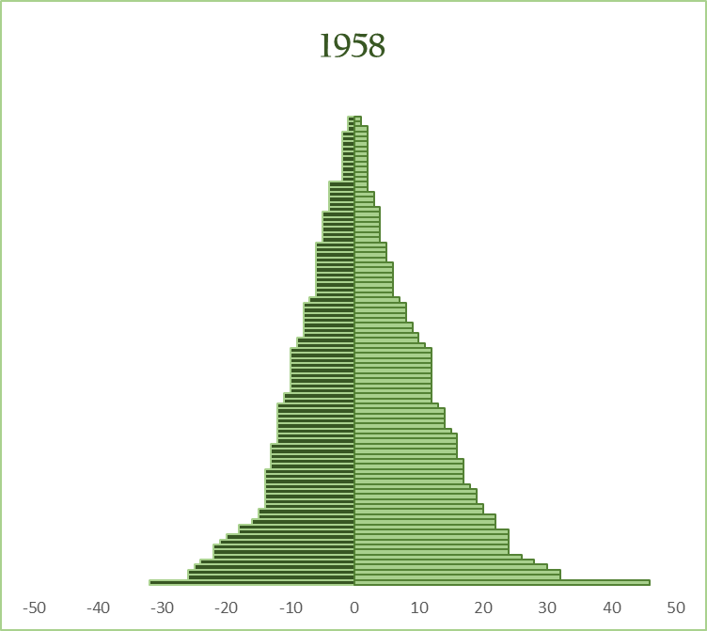
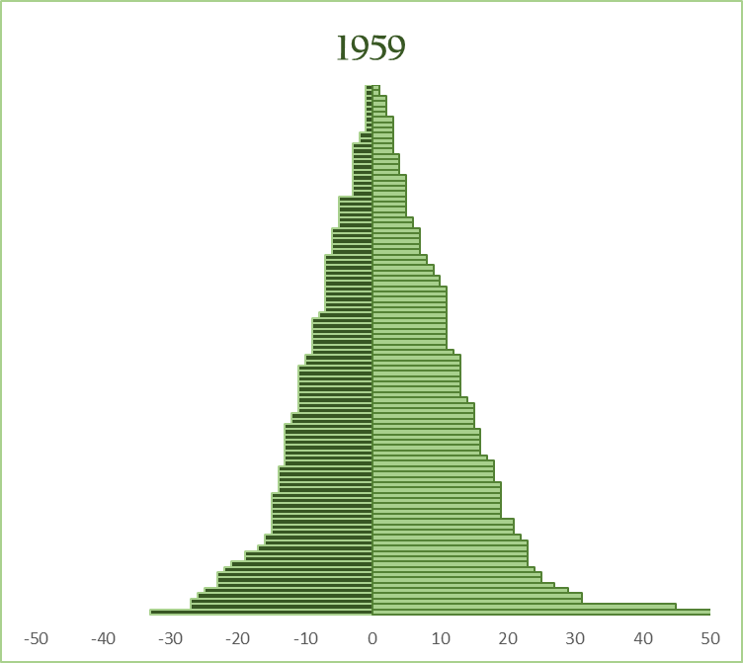
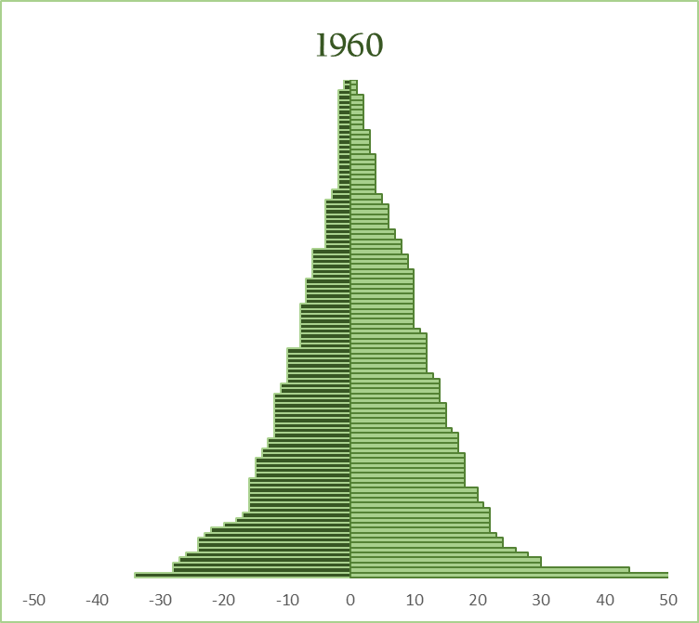
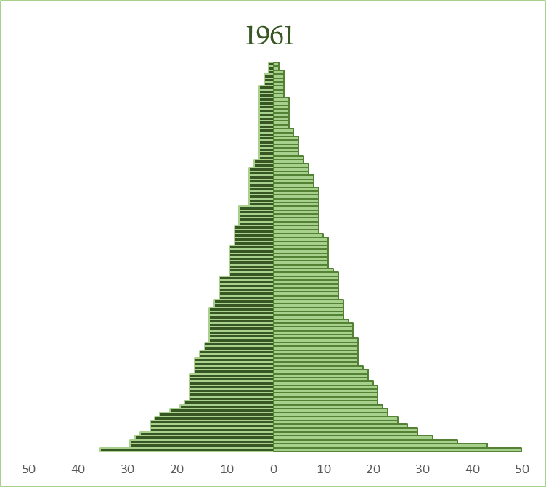
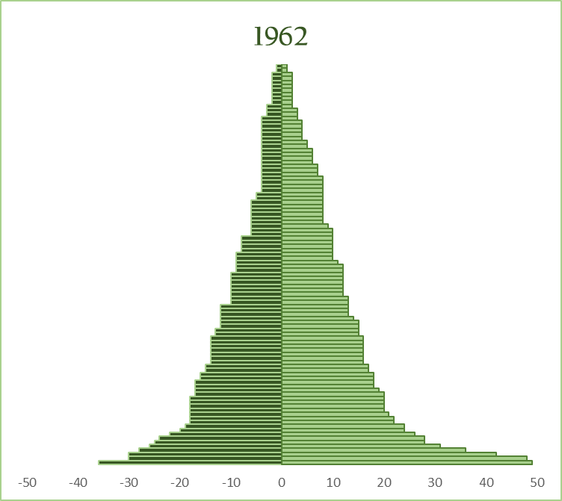








































































































































































U.S. Senate Membership Terms (animation)
1800-1980
Distribution of years served in Senate by senators in a specified year
Distribution of years yet to serve in Senate by senators in a specified year
50
40
30
20
10
0
10
20
30
40
50
Years served
Years remaining

Slide 35
In 2002 and 2004, only 98 percent of incumbents were re-elected. Appalled, incumbents are working to eliminate that awful 2 percent.’’
George F. Will

Slide 36





Fig. 1
100
a
b
75
seat
50
25
0
Senate Seats
100
c
d
75
50
25
Years
served
Years
served
Years
remaining
0
0
10
20
30
40
50
60
70
80
90
100
0
10
20
30
40`
50
60
70
80
90
100
Years
Years
Notes:
Figure 1. Model depiction of horizontal life-lines (congressional terms) for the 100 seats in the U.S. senate over a century. Each horizontal line represents a seat with the green ticks within the gray-shaded area indicating replacement of that seat. The solid green lines depict the years served by individual members who were jointly serving in year 0 (i.e., current). (a)random vertical distribution of lifelines for current members; (b)lifelines of current members ordered shortest to longest from top-to-bottom according to years already served; (c)lifeline segments of current members for years served and years remaining decoupled and each ordered shortest-to-longest from top-to-bottom.
Graphic contained in Hypothetical Identity Model (Excel)
Figure 1. Graphic depiction of the identity terms served equals terms yet to serve. Each horizontal line represents a fictional senator’s total years served divided into years served and years left. Panels in which lifelines are ordered; (a) randomly top-to-bottom; (b) according to years served; and (c) according years served and separately (decoupled from left-segments) according to years left.

Slide 37





Fig. 1
100
a
b
75
50
25
0
Senate Seats
100
c
d
75
50
25
Years
served
Years
served
Years
remaining
0
0
10
20
30
40
50
60
70
80
90
100
0
10
20
30
40`
50
60
70
80
90
100
Years
Years
Notes:
Figure 1. Model depiction of horizontal life-lines (congressional terms) for the 100 seats in the U.S. senate over a century. Each horizontal line represents a seat with the green ticks within the gray-shaded area indicating replacement of that seat. The solid green lines depict the years served by individual members who were jointly serving in year 0 (i.e., current). (a)random vertical distribution of lifelines for current members; (b)lifelines of current members ordered shortest to longest from top-to-bottom according to years already served; (c)lifeline segments of current members for years served and years remaining decoupled and each ordered shortest-to-longest from top-to-bottom.
Graphic contained in Hypothetical Identity Model (Excel)
Figure 1. Graphic depiction of the identity terms served equals terms yet to serve. Each horizontal line represents a fictional senator’s total years served divided into years served and years left. Panels in which lifelines are ordered; (a) randomly top-to-bottom; (b) according to years served; and (c) according years served and separately (decoupled from left-segments) according to years left.

Slide 38
Fig. 2
Senate Membership Life Cycle
Growth Phase
Senescence Phase
Predecessors (P)
Incumbents (I)
Successors (S)
b_{I} = d_{p}
b_{S} = d_{I}
T_{F}(=50)
40
30
20
10
T_{C}(=0)
10
20
30
40
T_{e}(=50)

Slide 39
Senate Membership Life Cycle
Completion
Senescence Phase
Predecessors (P)
Incumbents (I)
Successors (S)
Growth Phase
b_{I} = d_{p}
b_{S} = d_{I}
T_{F}(=50)
40
30
20
10
T_{C}(=0)
10
20
30
40
T_{e}(=50)

Slide 40


Fig. 3
20
(a) House
15
years served
Years
years remaining
10
5
0
20
(b) Senate
15
Years
10
5
0
1800
1820
1840
1860
1880
1900
1920
1940
1960
1980
2000
2020

Slide 41









Fig. 4a
US House of Representatives
Years
served
Years
remaining
House Seats
-50
-25
0
25
50
-50
-25
0
25
50
-50
-25
0
25
50
Years

Slide 42









Fig. 4b
US Senate
Senate Seats
-50
-25
0
25
50
-50
-25
0
25
50
-50
-25
0
25
50
Years

Slide 43






Fig. 6
50
U.S. House
1950
1980
40
1920
30
20
R²=0.9472
R²=0.9697
R²=0.9713
10
m=1.411
m=1.173
m=1.061
Years Remaining in Congress
0
50
U.S. Senate
1950
1980
40
1920
30
20
R²=0.9573
R²=0.9775
R²=0.9564
10
m=1.277
m=1.139
m=1.121
0
0
10
20
30
40
50
0
10
20
30
40
50
0
10
20
30
40
50
Years Served in Congress

Slide 44

Fig. 5
1.00
0.95
Correlation (R²)
0.90
Senate
House
0.85
1800
1820
1840
1860
1880
1900
1920
1940
1960
1980

Slide 45








100
Fig. 8
House
75
Growth
Senescence
Percent
50
25
1800’s
1900’s
0
100
Senate
75
Percent
50
1900’s
25
1800’s
0
50
40
30
20
10
0
10
20
30
40
50
YEARS
Notes:
Turnover sheet in Senate database

Slide 46

Distribution of Senator-years
in 1980 U.S. Congress
100
Years Served
Years Remaining
75
TURNOVER
50
50%
turnover
Predicted
Senators
Observed
25
75% turnover
95% turnover
0
1930
1940
1950
1960
1970
1980
1990
2000
2010
2020
2030
YEAR
Notes:
The Life Cycle of the 1980 U.S. Senate: Formation, Growth, Regression and Extinction

Slide 47






House Turnover
Fig. 7a
20
(a)
50%
Years Served
(b)
Years Remaining
15
Observed
10
Predicted
5
0
20
(c)
75%
(d)
15
10
5
0
45
(e)
95%
(f)
30
15
0
1800
1820
1840
1860
1880
1900
1920
1940
1960
1980
1800
1820
1840
1860
1880
1900
1920
1940
1960
1980

Slide 48






Senate Turnover
Fig. 7b
20
(a)
50%
Years Served
(b)
Years Remaining
15
Observed
10
Predicted
5
0
20
(c)
75%
(d)
15
10
5
0
45
(e)
95%
(f)
30
15
0
1800
1820
1840
1860
1880
1900
1920
1940
1960
1980
1800
1820
1840
1860
1880
1900
1920
1940
1960
1980

Slide 49





1980 U.S. Senate
100
R
R
75
$$\overline{c}=8.3 yrs$$
$$\overline{g}=13.4 yrs$$
Number Senators
50
D
D
25
$$\overline{c}=11.4 yrs$$
$$\overline{g}=11.0 yrs$$
Years Served
Years Remaining
0
1960
1965
1970
1975
1980
1985
1990
1995
2000

Slide 50




Computational Concepts for Years-in-Judiciary
(a)
(b)
Cross-sectional
e(0) = 20.3
(c)
Longitudinal
(d)
e(0) = 16.0
Years-in-judiciary
(e)
Cross-
Longitudinal
Extant
(f)
e(0) = 18.2
(g)
Cross-
Longitudinal
Extinct
(h)
e(0) = 17.5
1930
1970
2010
0
20
40
Year
Judiciary-years
Notes:
File: Courts folder CrossSectional_Longitutinal_230511

Slide 51


Slide 52
Actuarial Predictions for
U.S. House of Representatives
80
Age
Distribution
(n=435)
70
60
Age (years)
50
40
Predicted Death
Distribution
(10.4 deaths/cycle)
30
4
3
2
1
0
0.1
0.2
0.3
0.4
Number of Members
Deaths by Age
2-year Election Cycle
Notes:
FILE: Lifespan_Career_Macro (Actuarial Sheet)
Mean age House Members = 54.9
Mean age death distribution = 62.9
Total deaths/2-year cycle = 10.4
House of Representatives in 2000
30% women; so q(x) weighted 30:70 women to men

Slide 53


NBA: Distribution of Seasons Played and Remaining
NBA Roster: 450 players

Slide 54

Seasons Played in NBA
300
250
200
150
100
50
0
0
2
4
6
8
10
12
14
16
Seasons Played

Slide 55




(a)
(b)
Players
(c)
(d)
Seasons
played
Seasons
left
Seasons

Slide 56









































NBA Player Seasons Active (animation)
1960-2000
Distribution of seasons played in NBA by active players in a given year
Distribution of seasons remaining in NBA by active players in a given year
20
15
10
5
0
5
10
15
20
Seasons played
Seasons remaining

Slide 57

Player-year Ascendancy of
2000 NBA Roster
14 years
Example:
The 450 players who were in the NBA in 2000 accounted for three fourth of the player years during the 14-year period from 1993 through 2007.
Area in rectangle:
6,300 player-years
450 players
4,725 player-years
1993
2000
2007

Slide 58
Player-year Ascendancy of
2000 NBA Roster
95%
6 years
75%
14 years
50%
26 years

Slide 59
Stationary Populations:
Healthy lives lived and left
Medfly health
Human health

Slide 60




Supine Behavior in Medflies
live
supine
dead

Slide 61


Slide 62


(a)
(b)
150
100
50
0
50
100
150
TIME (days)

Slide 63

Average of
9.7 days left
Average of
34.0 days left

Slide 64
Baltimore Longitudinal
Aging Study

Slide 65

Baltimore Longitudinal Study
Systolic Blood
Pressure
(mm Hg)
< 140
> 140
0
20
40
60
80
100
AGE (years)

Slide 66




Baltimore Longitudinal Study
Systolic Blood Pressure
(mm Hg)
< 140
> 140
Life lived
Life left
100
80
60
40
20
0
20
40
60
80
100
years

Slide 67


Baltimore Longitudinal Study (Systolic Blood Pressure)
No hypertension:
e(0) = 75.7 years
No hypertension:
Avg = 75.7 years
Hypertension:
Avg = 81.5 years
Hypertension:
e(0) = 81.5 years
Life lived
Life left
100
80
60
40
20
0
20
40
60
80
100

Slide 68


Stationary World Population:

Slide 69
World Fertility
United Nations (2019)
150
109 countries
100
98 countries
Number of Countries
Below or equal to
replacement
Above
replacement
50
0
> 2.1
< 2.1
Fertility
Notes:
UN: World Population Prospects
World Population Prospects - Population Division - United Nations

Slide 70

World
Life Lived and Left

Slide 71






World
Life Lived and Left

Slide 72

Years Difference in
Life lived and left
20
World
15
10
U.S.
Years Difference
Italy
5
0
-5
-10
1950
1960
1970
1980
1990
2000
2010
2020
2030

Slide 73





Next Steps
Generalize (lived/left)
Explore interdisciplinarity
Test theory (symmetry)
Stationary world population
New analytical tool
Population
Life Table
Notes:
Professional meetings
Proposals
Teaching
Business report organization’s executives

Slide 74
THANK YOU
QUESTIONS
Notes:
Professional meetings
Proposals
Teaching
Business report organization’s executives

